Slide 1




PITCH
BENEFICIARY

Slide 2

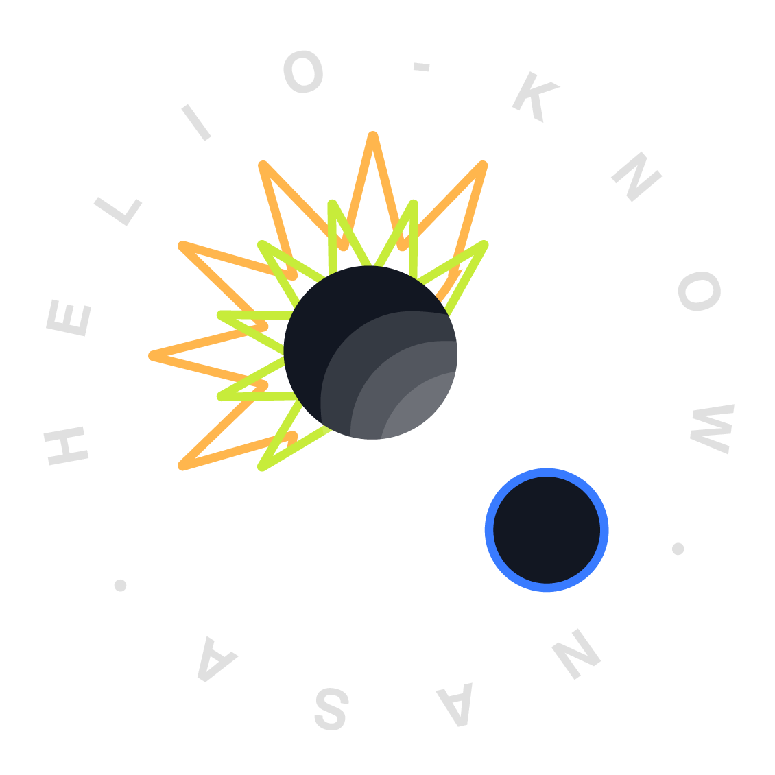
01 The Challenge
Context, pain points, etc?
02 The Solution
Features and Benefits
03 The Demo
Mockup(s), Schema
Helio-KNOW | Summary

Slide 3
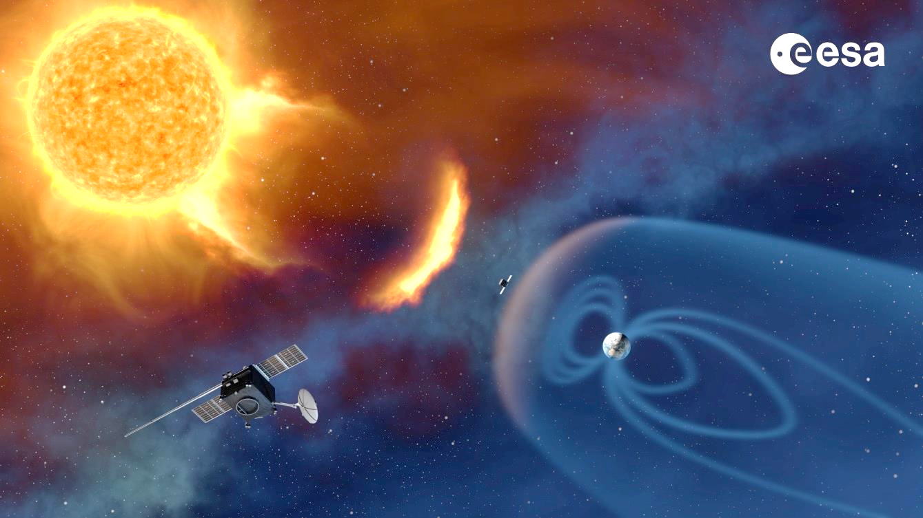
Helio-KNOW | 01 The Challenge
Context
Heliophysics examines the interconnected components of a dynamic system, driven by solar, planetary, and interstellar factors, resulting in space weather phenomena. Researchers aim to uncover key mysteries such as solar variability and its impacts on Earth's magnetosphere/ionosphere. However, despite access to vast datasets, the field lacks platforms for comprehensive data integration and analysis, limiting progress.
Image credit: ESA (European Space Agency).

Slide 4
Helio-KNOW | 01 The Challenge
Pain points
Researchers struggle with diverse data formats, making synthesis time-consuming and demanding. There's a need for systems that simplify complex phenomena for diverse stakeholders.
Interdisciplinary collaboration faces obstacles like differing terminologies and data sources, hindering data exploration due to network and storage limitations.
Moreover, for data science teams, there's a learning curve involved in understanding concepts like knowledge graphs and technologies such as Neo4j. Additionally, acquiring knowledge of physics concepts further adds to the challenge of effectively leveraging data science approaches in interdisciplinary research.

Slide 5
Helio-KNOW | 02 The Solution
Solutions
Provide an User Interface that allows researchers to explore Heliophysics data in an intuitive way.
This platform allows users to:
Easily discover data by providing a simplified navigation that can progressively getting more and more complex.
Explore data in different modalities such as: Networks, Tables and Timelines.
Save queries to continue working in the future.
Additionally we will provide a Cypher query to add nodes and relationships from concept map into Neo4j.

Slide 6
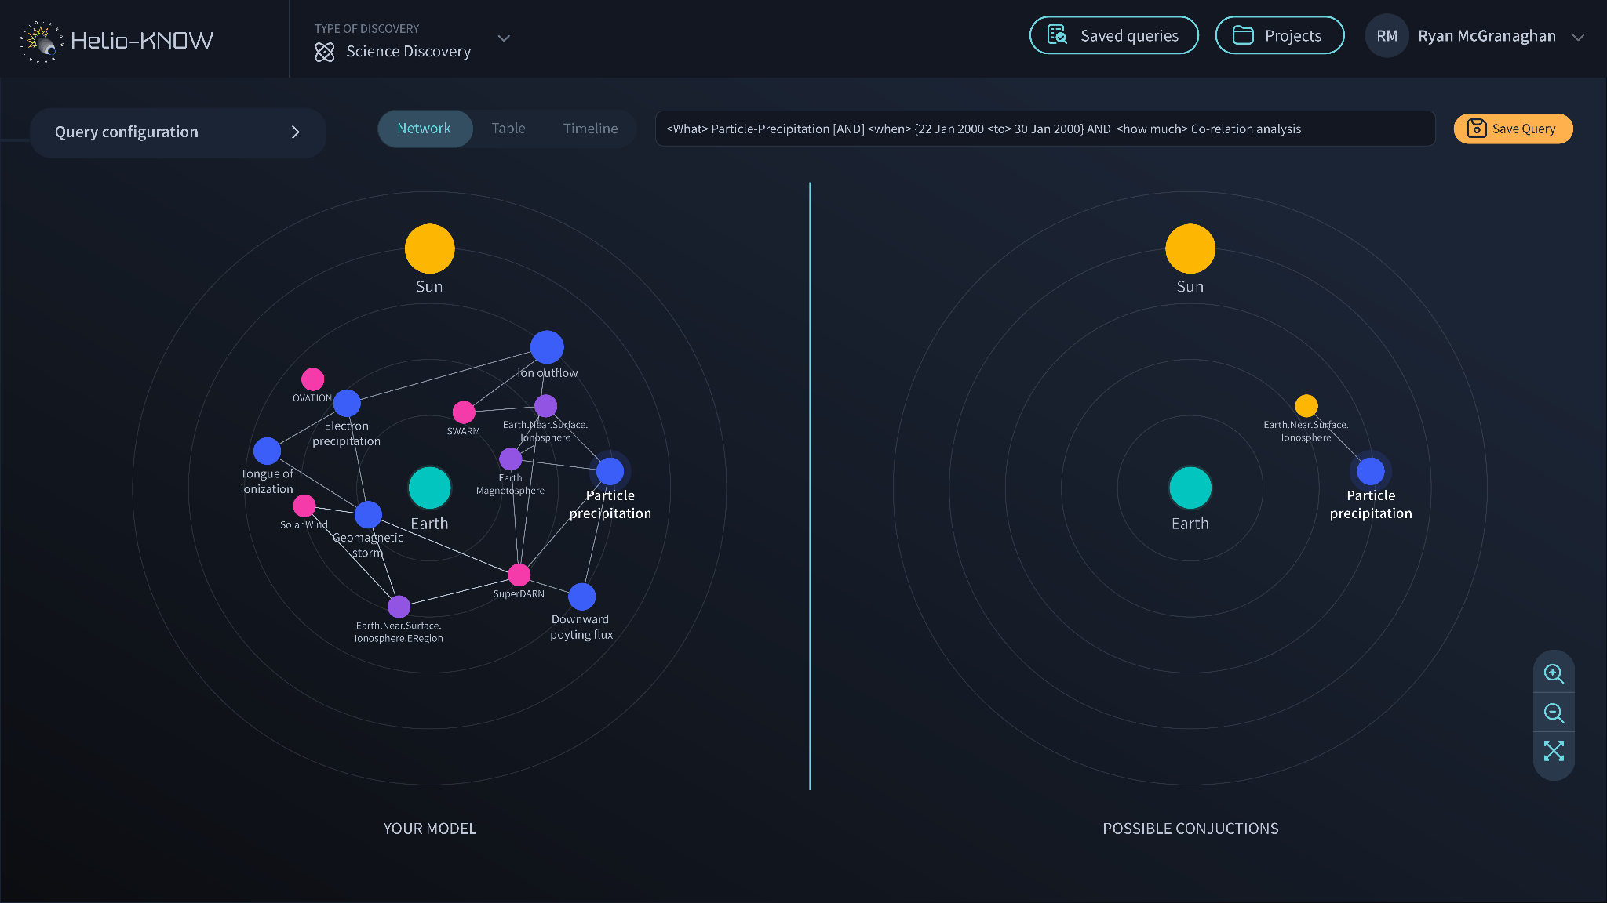
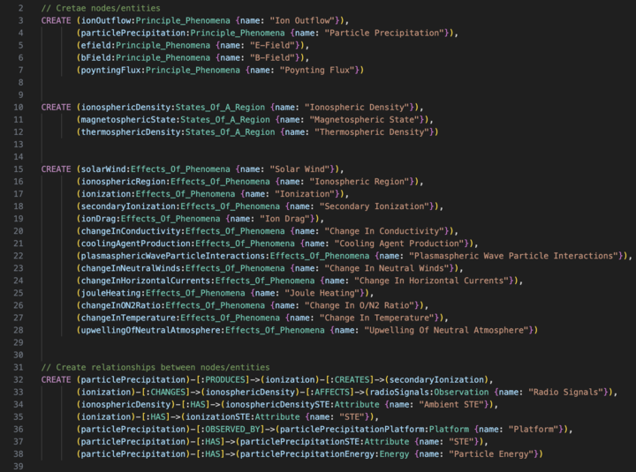
Helio-KNOW | 03 The Demo
Data science: Cypher Query
Helio-KNOW platform: Model comparison

Slide 7
Helio-KNOW | 04 The Team
Harini Muralidharan
UX Design (or HCI?) - Project Manager (shared)
Grazia Maszak-Prato Peraza
UX Design - Project Manager (shared)
Eric
Data Science
Support
Sagar Yadav
Data Science

