Slide 1

My Micasa
A platform for creatives to host events, share revenue, and build community. I’ll highlight the problem, key features, and how our design drives more connection and trust.

Slide 2
Content overview
1
2
3
Introduction
Problem
Research
4
5
6
Personas
Solutions
Long Term Goals

Slide 3
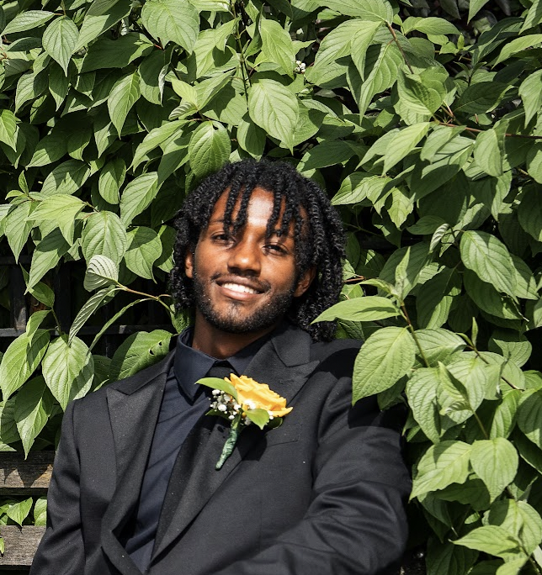
Bereket Barkley
SPOTLIGHT
UX Designer
Junior at Morehouse College
Art History Major
Minors in Art and Data Science
And a Commision Based Painter
Contact:
bereketbarkley@gmail.com
347-453-5541

Slide 4

I design accessible, user-first tools that solve real problems and build meaningful connections. My focus is on clarity, inclusion, and creating experiences that truly serve people.
MY MISSION

Slide 5
How might I improve Micasa’s UI experience to create more of a familial culture?
Problem statement
Bereket Barkley
UX Designer

Slide 6
Conducting Research
Context
Key players
User segments
I used the survey in the resources, conducted secondary research and a competitive analysis to come to my conclusions on the best way to help the users.
Meetup
Bizzabo
Login
Home Page
Energy/Vibe
Happy Path
Eventbrite
Ticketmaster
Partiful
Market value
N/A
Historic growth rate
20–35%
Posh
Projected growth rate
25–40%
per year
Cost of entry
2k

Slide 7
Based on my analysis, growth can come from our login, home page, and culture of the app. There are three main problems that are worth noting and I will be tackling in my designs.
THE OPPORTUNITY
Key learning 1
People want to be able to browse freely and get recommended spots.
Key learning 2
The homepage is not allowing for as easy and simple happy path as the company thought.
Key learning 3
Gamification causes users to use the sight more and be more motivated to do x y and z

Slide 8
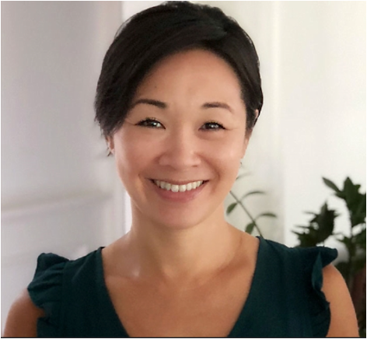
Maya Thompson is a freelance curator who needs a reliable way to manage events because current tools are inconsistent and lack of community-focused features.
Problem Statement
Needs and motivations
•Create and host 1–2 events per month with consistent attendance
•Build a loyal following who return to her events regularly
••Make event setup and marketing fast and visually appealing
Pain points
•Unreliable RSVPs—people say they’re coming but don’t show up, or come without RSVPing
•Marketing is time-consuming and unpredictable in impact
Full Name
Maya is a rising creative in Brooklyn known for her intimate comedy nights and pop-up art mixers. While she’s passionate about curating fun, expressive spaces, her biggest challenge is consistency
How we can help
•Help Maya make sure her Rsvp’s are reliable
•Make sure it’s easy to reachout to host
•Recommend her events to those who have already attended

Slide 9
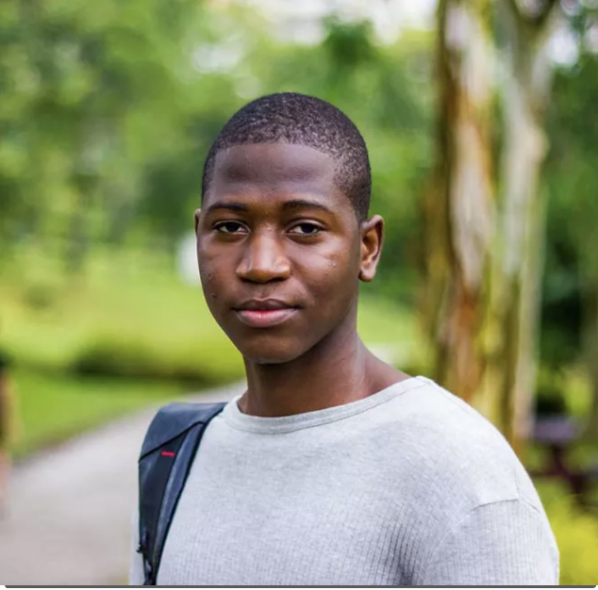
Jordan is an artist college student who needs a simple way to stay connected events and hosts they like because current methods are scattered and spammy.
Problem Statement
Needs and motivations
•Easily discover events that match their creative energy or social vibe
•Find events hosted by familiar people or friends-of-friends
•Stay in the loop on similar events after attending one they liked
Pain points
•Gets overwhelmed by too many random events with no connection
•Dislikes creating accounts or jumping through hoops to RSVP
Full Name
Jordan is a college student who loves curated music pop-ups, art parties, and community events—especially when invited by people they trust. They want an easy way to stay connected to events and hosts they enjoy, without spam or endless searching.
How we can help
•Create an easy way for him to find events
•Make sure he can freely browse until payment

Slide 10
Solutions

Slide 11
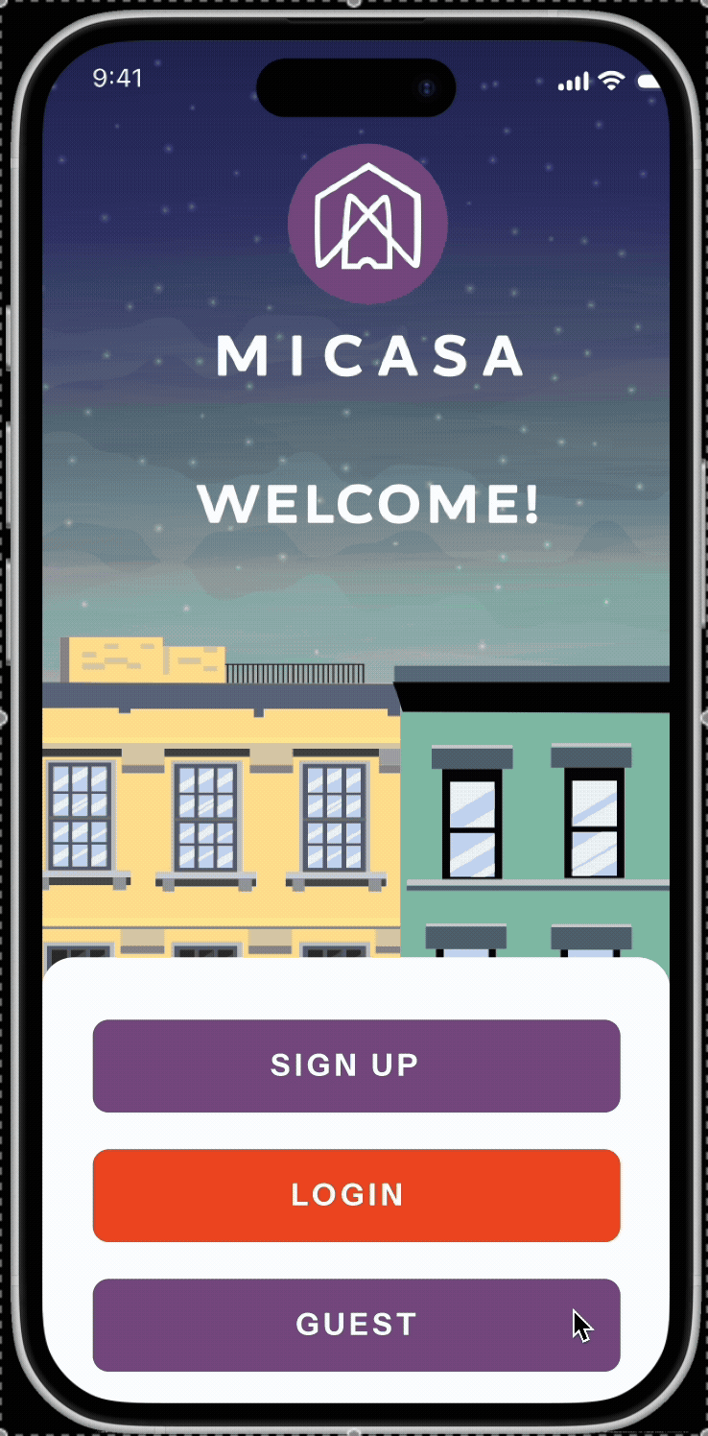
Home Page - Guest/User
Improvement 01
Removed the calendar and maps
Put the calendar and maps on the menu
Added Recommendation section
Based on past data and tickets bought
Added pricing of for users
Users make decisions based on pricing

Slide 12
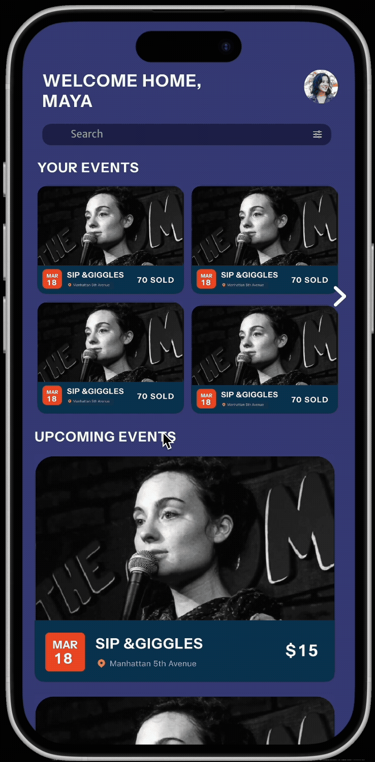
Home Page - Host
Improvement 01
Removed the calendar and maps
Put the calendar and maps on the menu
Added Events section
So Hosts can track there events
Added pricing of for users
Users make decisions based on pricing

Slide 13
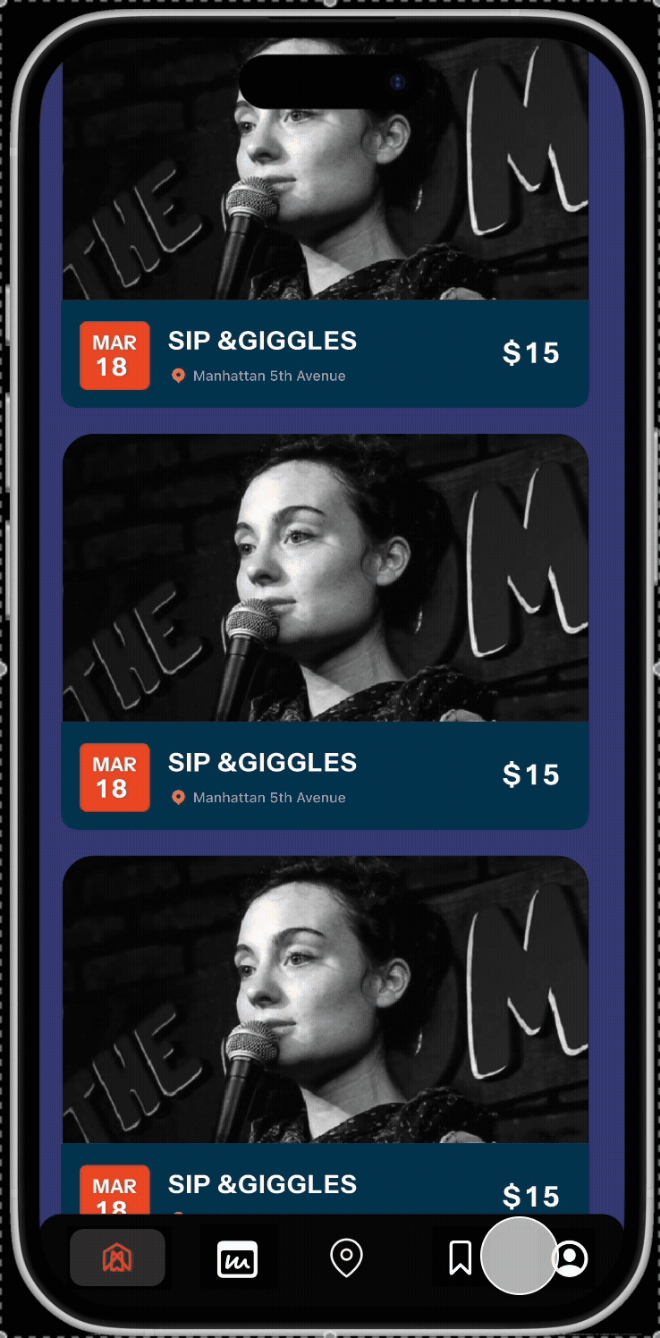
Gamification - Guest/User
Improvement 02
Removed map/Replaced with Rank
Put the ranking menu in replacement of the map
Included Rank Page
So users can track their progress
Added Rewards section
Users can earn rewards after to said tasks

Slide 14
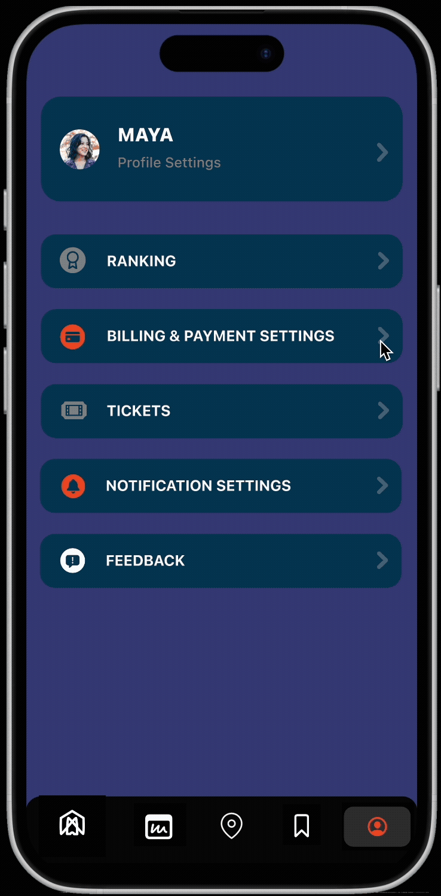
Gamification - Host
Improvement 02
Removed map/Replaced with Rank
Put the ranking menu in replacement of the map
Included Duo rank
So host cant track both their user and host rank
Added Rewards section
Users can earn rewards after to said tasks

Slide 15
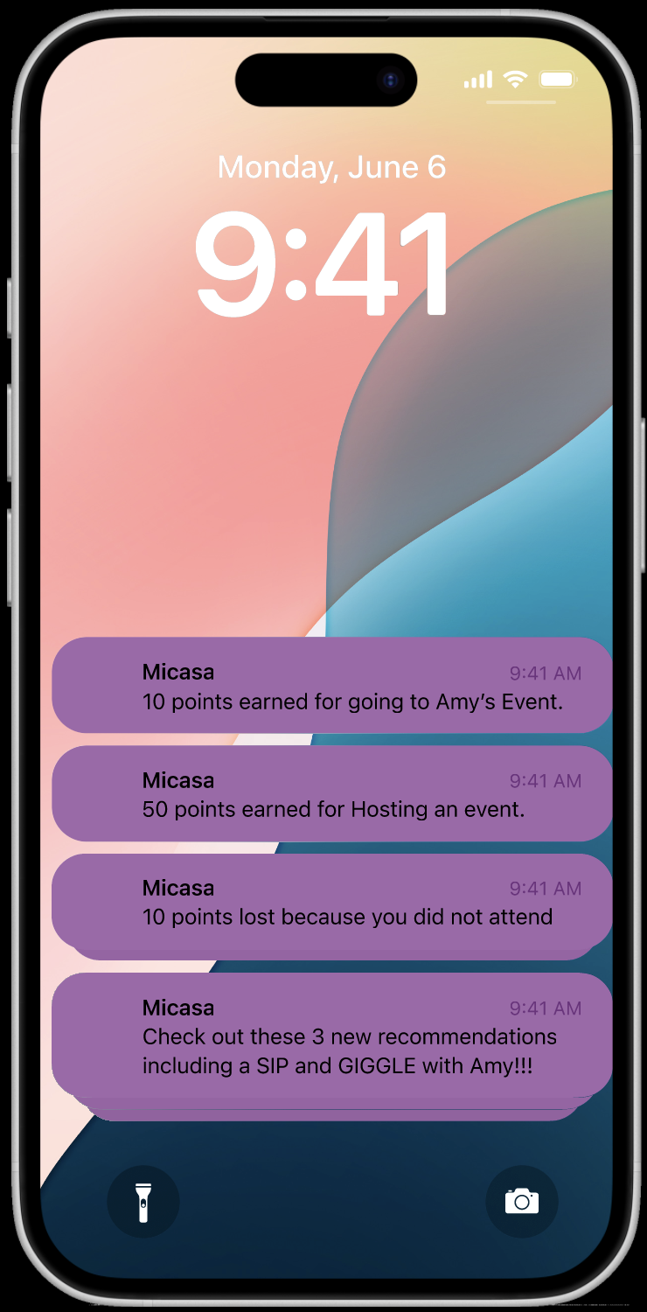
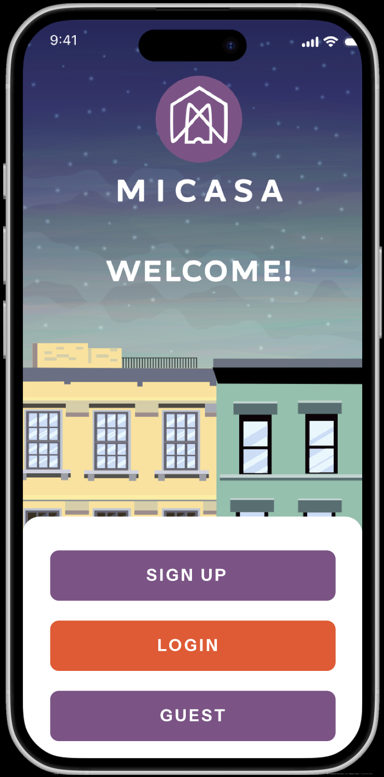
Guest Login & Notification
Improvement 03
Added Guest
Allowing users to browse
Notifications
For rewards/recommendations and more

Slide 16
Long Term Goals
OPERATIONAL PLAN
Research
Make sure the changes haven’t created the ranking as a status symbol instead of the intended purpose of helping one another. Implement changes as you see the users response.
Create rewards
Make it more incentivised to use to app and to host/co-host and attend events. Give out free tickets for great users and how “family” events in different cities to select users.
Gamification
Creating rank system that rewards members for doing more for the “family”. Including writing reviews, showing up to rsvps and more.
Basic Improvements
Implement a guest login function and change the home page layout.
01
02
03
04

Slide 17
I would love to keep in touch.
NEXT STEPS
Contact
Bereket Barkley
UX Designer
bereketbarkley@gmail.com

Slide 18
Thank you

